Slide 1
USER INTERFACE USING HAND GESTURES
IT890- Seminar Project
Done By:
Natasha Jain (222IT023)
Under the Guidance of:
Jaidhar C.D.

Slide 2
PROBLEM STATEMENT
Build a framework to control the mouse cursor using Google’s mediapipe to help users navigate through the operating system along with some keyboard functions.

Slide 3
INTRODUCTION
Hand gesture recognition is an essential component of human-computer interaction (HCI) as it makes it possible for people and computers to communicate in a manner that is more organic and instinctive.
The limited availability of large-scale datasets for the purpose of training and evaluating the performance of gesture recognition algorithms is one of the primary obstacles that must be overcome in the field of hand gesture recognition

Slide 4
INTRODUCTION
MODULES USED:
MEDIAPIPE: "MediaPipe offers cross-platform, customizable ML solutions for live and streaming media.".
PyAutoGUI :“PyAutoGUI lets your Python scripts control the mouse and keyboard to automate interactions with other applications.”

Slide 5
METHODOLOGY
MEDIA PIPE FRAMEORK
Image Frame
Cropped Palm
Region
Web Camera Feed
Palm Detection
Landmark Model
Landmark Points
42 Normalised Points
Save Trained Model
Prediction Model Training
Data Normalisation
Class Label

Slide 6
METHODOLOGY
Detection of Your Palm
Predictions based on the Skeleton landmark
The process of spatial normalisation
Instruction in Neural Model Design and Construction
Predictions Based on Gestures
Taking the Appropriate Steps to Act

Slide 7
METHODOLOGY
PALM DETECTOR:
Takes image frame as input.
Detects palm(s) in a frame along with handedness.
Outputs the cropped image of the detected palm.
LANDMARK MODEL:
Takes palm detector’s output as input.
Processes the image and gives for landmark skeleton.
Provides landmark points as output vector.

Slide 8
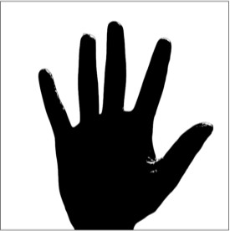
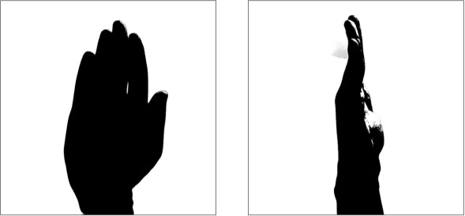
GESTURES
For hovering
For Changing Application Window For Closing Current Window

Slide 9


GESTURES
For Single Click Double Click (right)
For Scrolling Up Scrolling Down (right)

Slide 10
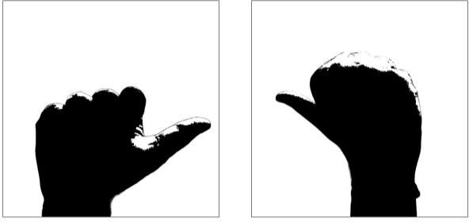
GESTURES
Pressing Left Button Pressing Right Button

Slide 11
REFERENCES
https://www.researchgate.net/publication/326780110_Ha nd_Gesture_Recognition_Using_Convolutional_Neural_ Networks_and_Depth_Camera
https://openaccess.thecvf.com/content_cvpr_2018_works hops/papers/w37/Mencattini_RealTime_Hand_Gesture_CVPR_2018_paper.pdf
Study and Verification on the Latch-Up Path Between I/O pMOS and N-Type Decoupling Capacitors in 0.18--m CMOS Technology | IEEE Journals & Magazine | IEEE Xplore
https://openaccess.thecvf.com/content_ICCV_2019/paper

Slide 12
THANK YOU

